Slide 1
A Practical Method to Estimate the Spatial Resolution of GEM Detector
Rensheng Wang (王仁生)
Tsinghua U. (清华大学)
Collaborators: Yan Huang, Zhi-Gang Xiao, Zhao Zhang
Rong Wang, Haiyan Gao
The Fourth Workshop on Hadron Physics in China
and Opportunities with 12GeV JLab

Slide 2
Outline:
Introduction
Method description
Experimental results
Near future plans
Summary

Slide 3
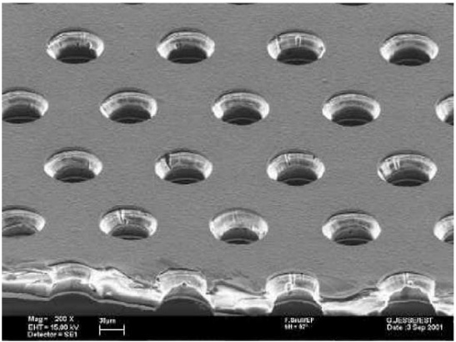
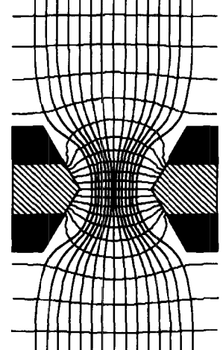
Brief introduction to GEM detector
-HV
Cathode
~2-30 mm
Drift /Sensitive(~1-3kv/cm)
GEM1(300v-500v)
~1-2mm
Transfer(~1-3kv/cm)
GEM2(300v-500v)
~1-6mm
Induction(~1-3kv/cm)
Anode/Readout strip

Slide 4
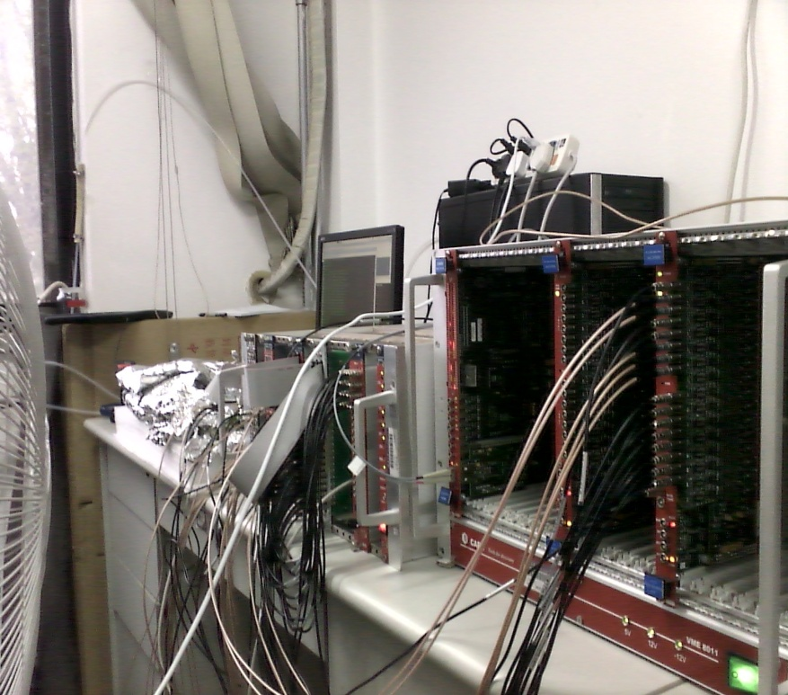
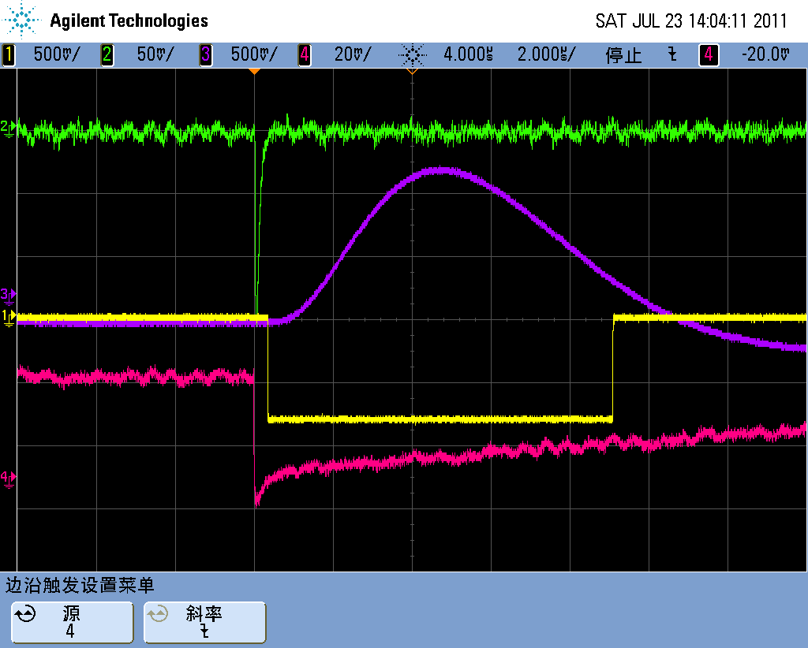
Introduction to the set up
⁵⁵Fe
Readout strip: 1-D, width=200um, 400um;
2-D, width=400um
Preamplifier: Charge-sensitive, 16 channels
DAQ: Based on VME-Bus, peak sensitive ADC

Slide 5
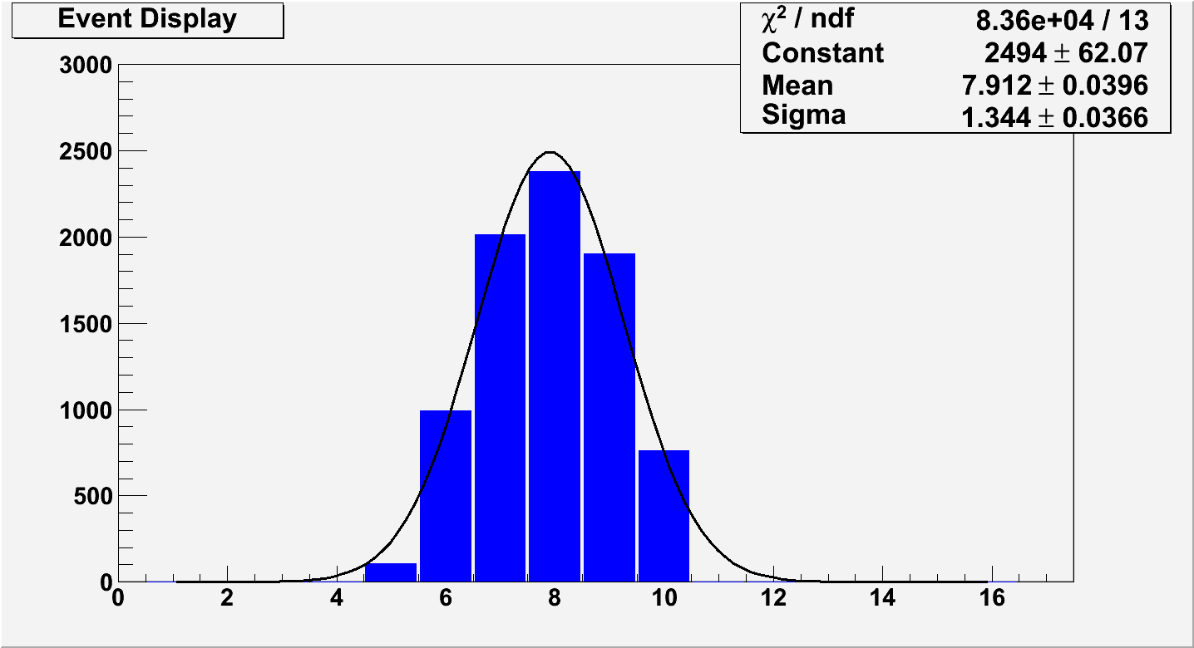
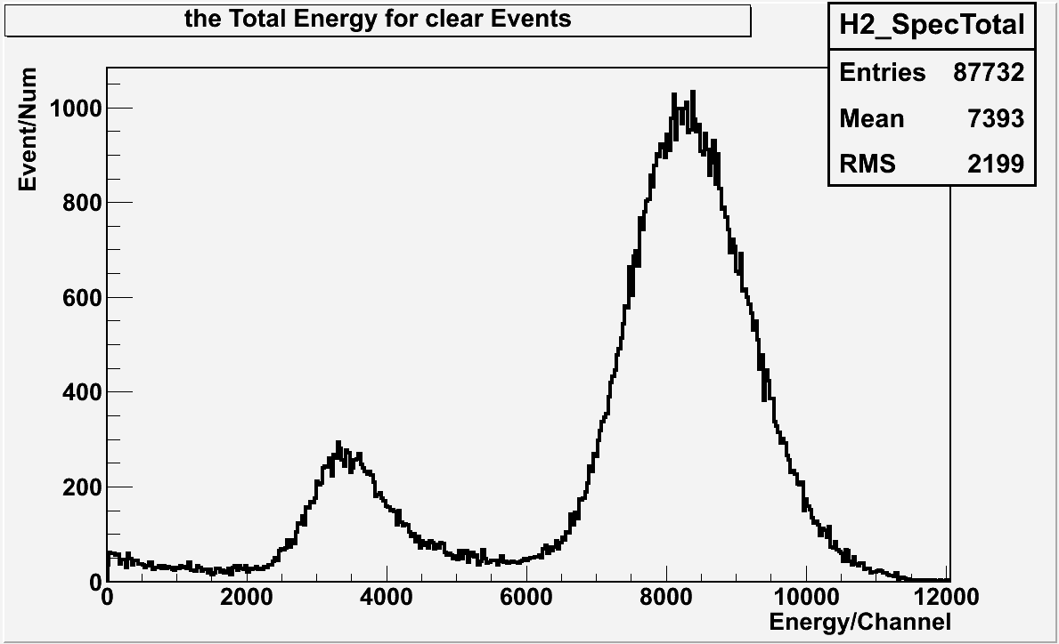
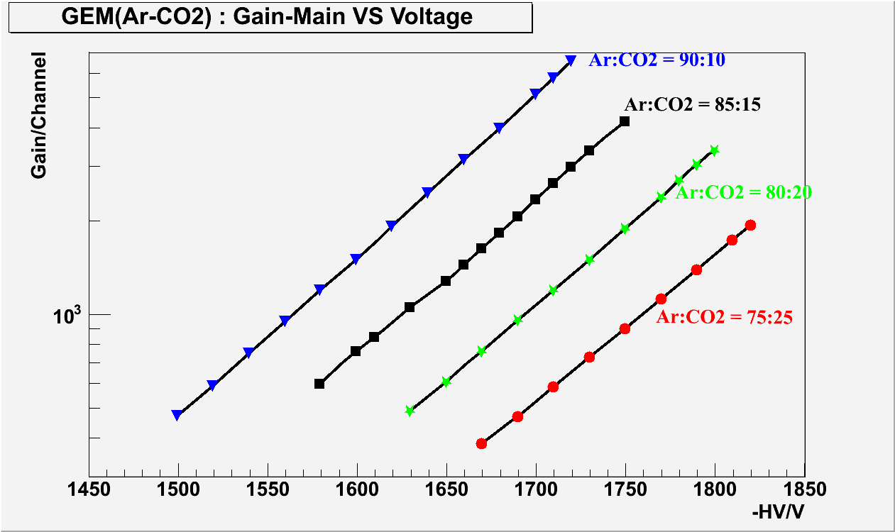
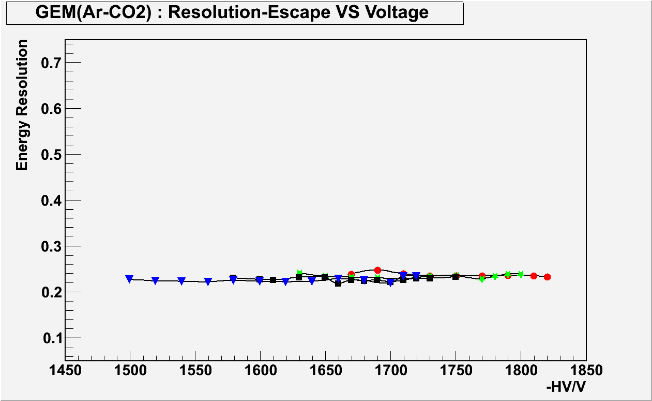
General performance

Slide 6
Method description

Slide 7
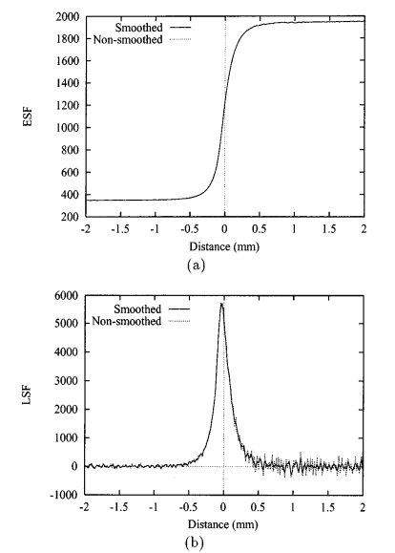
Conventional methods for spatial resolution
Method Ⅰ:
Method Ⅱ:
Method Ⅲ :
Ref：
1，RADIOLOGY 93: 257-272, August 1969.
2，Med. Phys. 25(1), January 1998
3，Med. Phys. 11(6), 1984

Slide 8
Comparison of different methods
#Method | σ₀ /μm
Method 1 (slit width=200μm) No deconvolution | 1314.9
Method 1 (slit width=200μm) With deconvolution | 65.0
Method 1 (slit width ~10μm) | 59.9
Method 3 | 71.3
Method 3 (with improved data processing) | 63.3
Ref: Chinese Physics C, Vol. 36, No. 3, Page 228-234
Difficulties：
Method 1: Precise slit fabrication and alignment in the radiation；
or intense radioactive source；
Method 2: Complex auxiliary equipment；
Method 3: Precise edge fabrication and collimated X-ray source needed;

Slide 9
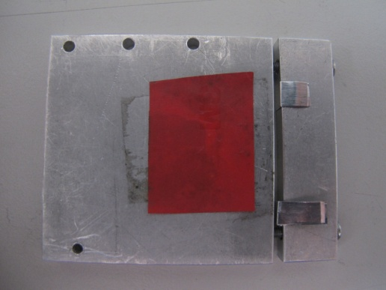
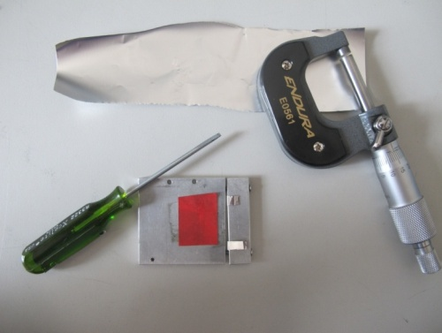
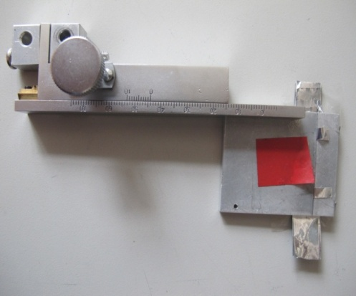
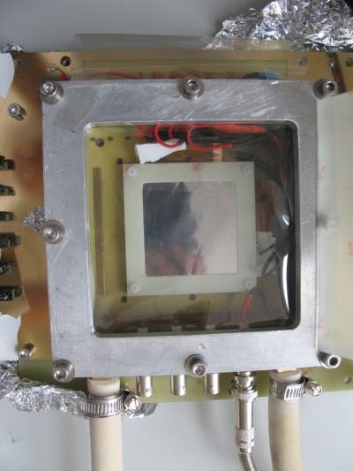
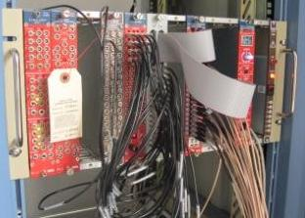
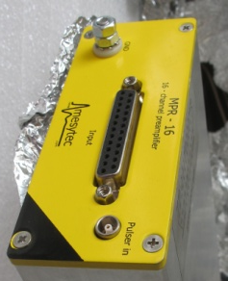
But, what we have:
2, a ⁵⁵Fe with low
Activity (5 × 10⁴ Bq), Surface source, s～0.78cm²
1，A slit with adjustable width, but the width can NOT be measured precisely.
3, Very limited in electronics
(16 channels);
It is natural to use method 1. But…

Slide 10
A practical method
⁵⁵Fe(Surface source)
But, the slit width can NOT be measured precisely.
Luckily:

Slide 11
A practical method (Continue)
⁵⁵Fe(Surface source)
therein, n means the counting rate

Slide 12
Simulation Results(1-D)
Simulation conditions：
GEM spatial resolution：70μm；
Slit thickness(mm)：3, 4, 5, 6, 7;
Slit width(μm):20,30… 100;
The angle(slit with readout strip, deg):1.0, 0.5, 0.25, 0.125;

Slide 13
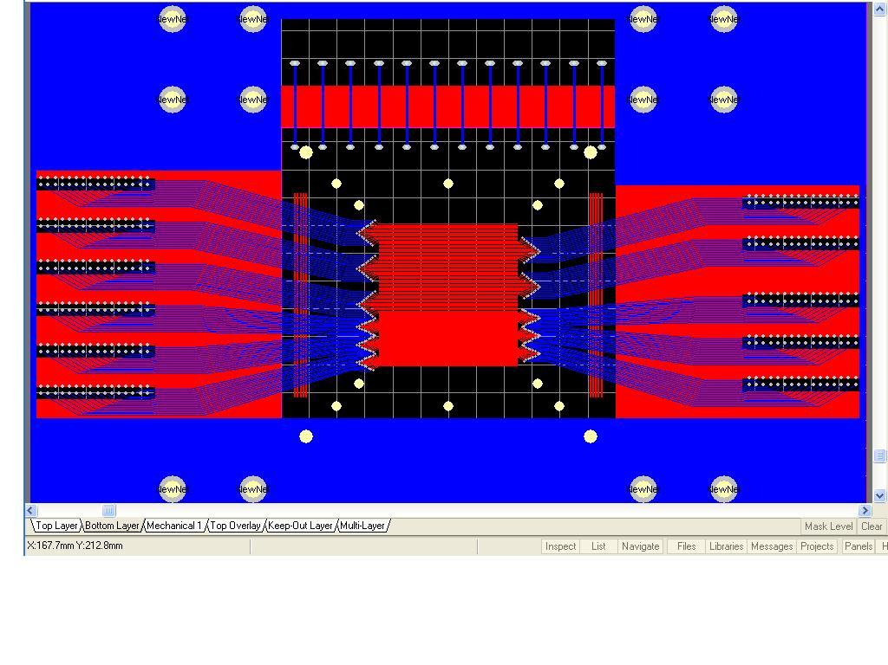
Experimental result
1-Dimension Readout
Readout strip: D=200um 400um;

Slide 14
When W≈40μm:
1, (a): get the events from main peak(mean ±2σ), covered with the red line;
2, (b): calculate the position by the centre-of-gravity method; subtract the background(under the blue dotted line), then fit it with gaus-func;
3,
Therein: S-the area of main peak; T-the testing time

Slide 15
The Test result(1-D, 200μm readout strip)
(1), When w ≈40, 50,60,70,80μm,
with the ratio as the x axis, with the σ²_{tot} as the y axis.
(2), Fit the graph with line-func, we can get
σ_{GEM}=56 ±15μm

Slide 16
The Test result(1-D, 400μm readout strip)
σ_{GEM}=41 ±79μm

Slide 17
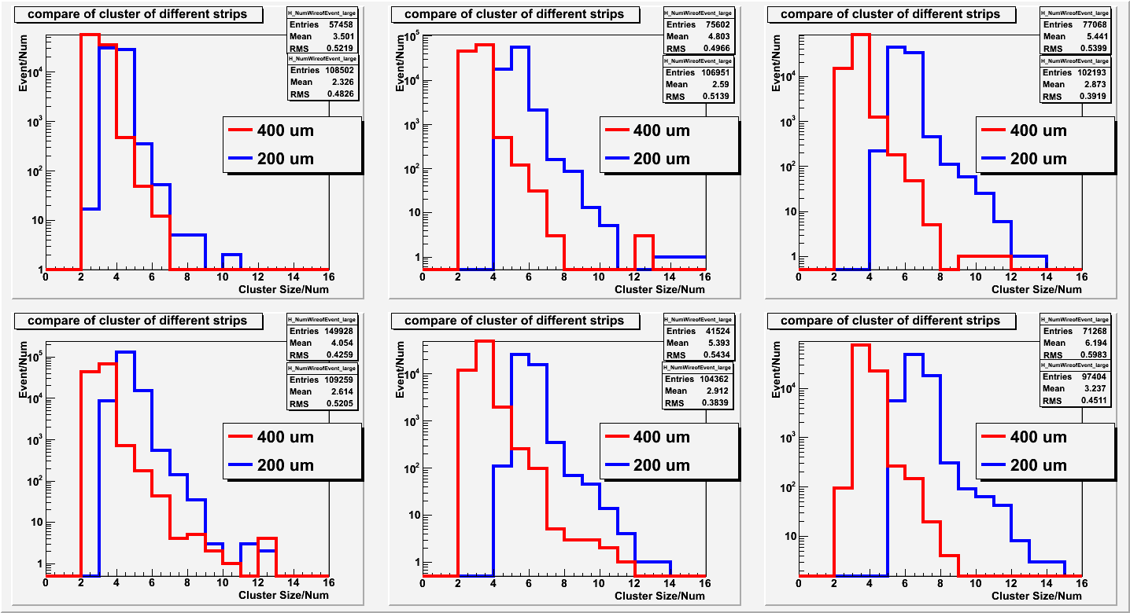
Cluster size of signal of main peak
-HV
1710
1750
Ar | 75 | 80 | 85

Slide 18
Near Future Plans
Further test:
  Position resolution for 2-D detector;
  Simulation with Garfield;
  Time resolution;
A prototype for SoLID
APV electronics (1024)
Asic-based electronics
Develope the new DAQ
~45cm
~48cm
~20cm

Slide 19
Summary
GEM-Detector prototype test is ongoing in our lab;
A new method to evaluate the GEM spatial resolution:
1) For 1-D and W_{readout}=200μm, σ_{gem}=56±15μm(1σ);
2) Global performance tested for the prototype ;
Consistent with literature report
Next step is to build a prototype for SoLID with new electronics and DAQ;
Looking forward to the arrival of the GEM foil and the APV electronics
Supported by the National Natural Science Foundation of China
and Tsinghua University Initiative Scientific Research Program .

Slide 20
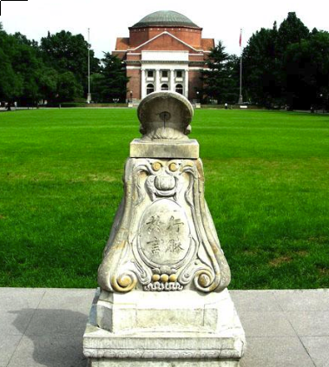
Thanks！

